Slide 1
Dog Breed Identification Using Transfer Learning
SlideMake.com

Slide 2
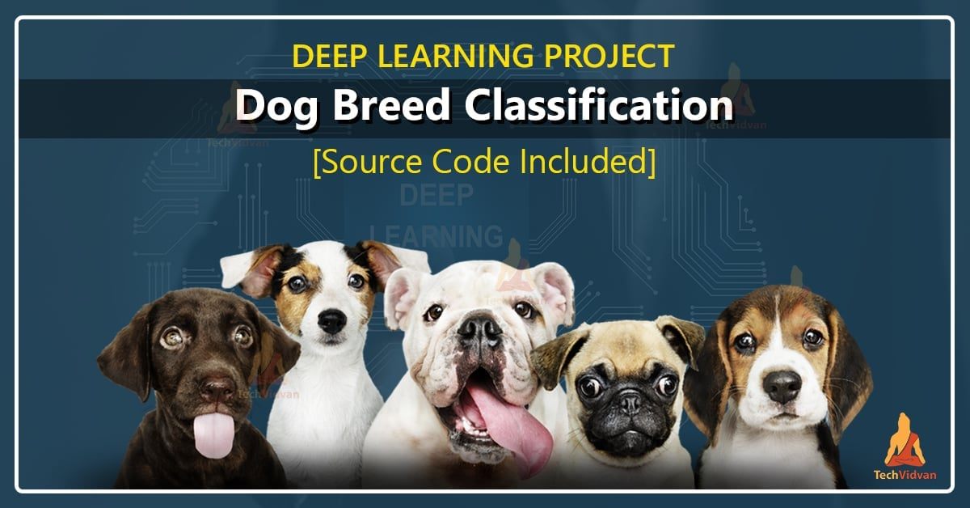
Introduction to Dog Breed Identification
Dog breed identification involves classifying images of dogs into specific breeds.
Accurate identification helps in pet management, health monitoring, and breed-specific care.
Transfer learning has emerged as a powerful technique to enhance breed classification accuracy.
Notes:
Image source: https://techvidvan.com

Slide 3
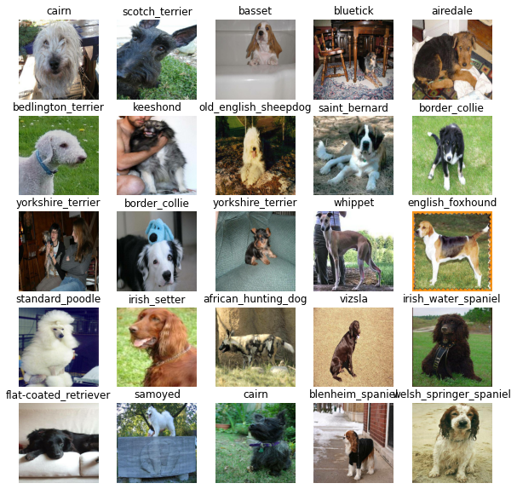
Challenges in Dog Breed Identification
Variability in images due to different angles, lighting, and backgrounds complicates identification.
Many breeds have similar physical features, making differentiation difficult.
Collecting and annotating large datasets for training models is time-consuming and costly.
Notes:
Image source: https://user-images.githubusercontent.com

Slide 4
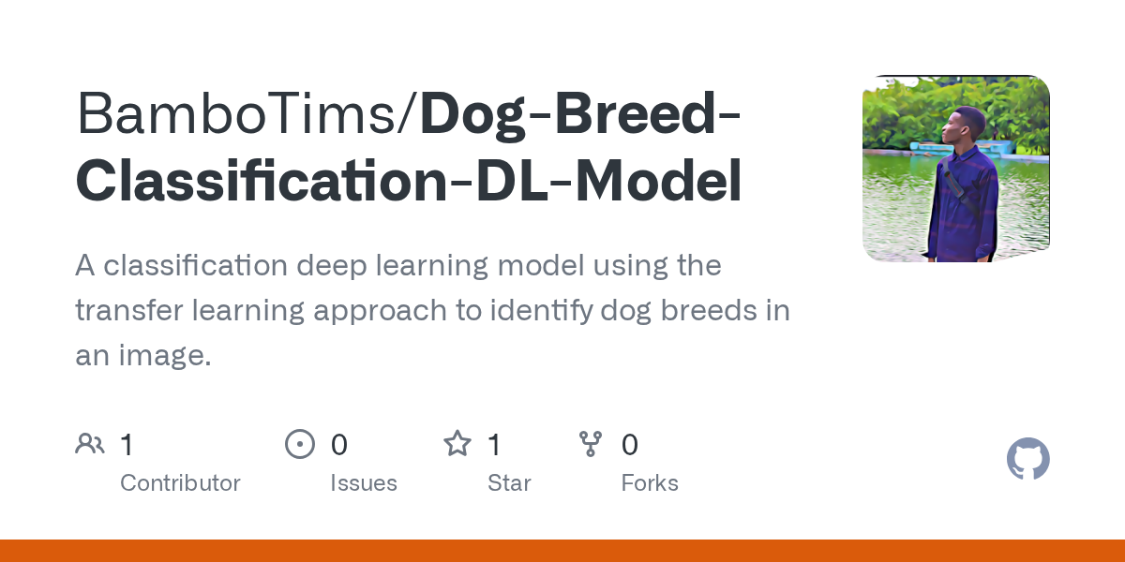
What is Transfer Learning?
Transfer learning leverages pre-trained models on large datasets for new, related tasks.
It involves fine-tuning a model trained on one dataset to work on a different but similar problem.
This approach reduces training time and improves performance, especially with limited data.
Notes:
Image source: https://opengraph.githubassets.com

Slide 5
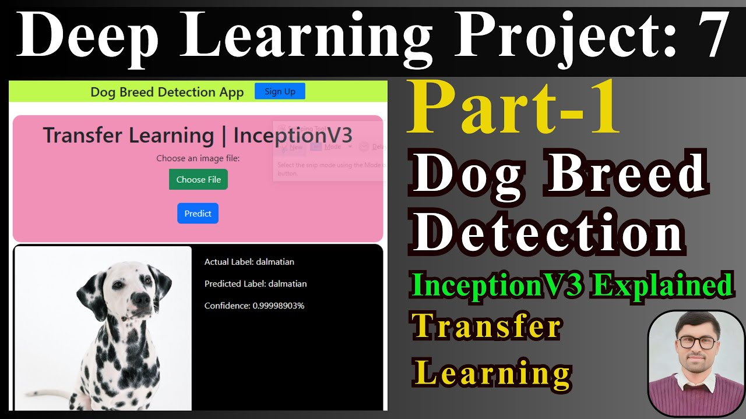
Popular Pre-trained Models for Transfer Learning
Convolutional Neural Networks (CNNs) like VGG, ResNet, and Inception are commonly used.
These models are trained on ImageNet, which contains millions of labeled images across thousands of categories.
Using these models as feature extractors allows for effective dog breed classification.
Notes:
Image source: https://i.ytimg.com

Slide 6
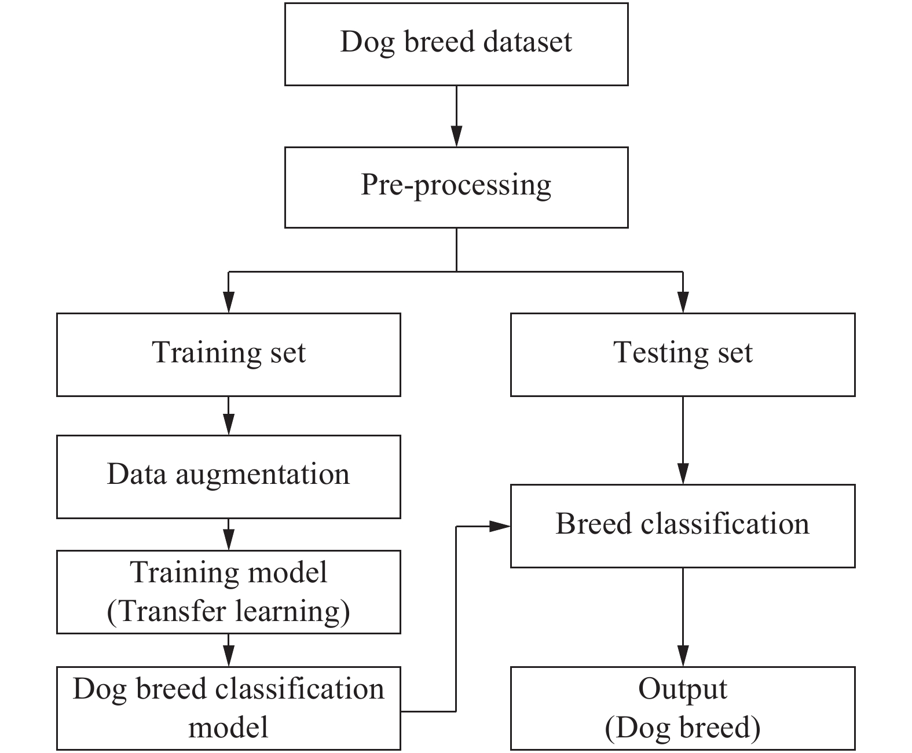
Methodology Overview
Collect a labeled dataset of dog images across various breeds for training and testing.
Choose a suitable pre-trained model and adapt it by replacing or adding classification layers.
Fine-tune the model on the dog dataset to optimize breed recognition accuracy.
Notes:
Image source: https://www.mi-research.net

Slide 7
Data Preparation and Augmentation
Organize images into breed-specific folders for structured training.
Apply augmentation techniques like rotation, flipping, and scaling to increase data diversity.
Normalize images to match the input requirements of the pre-trained model.
Notes:
Image source: https://www.mi-research.net

Slide 8
Model Training and Evaluation
Use transfer learning to train the model with a fraction of the original training time.
Evaluate the model’s performance using metrics like accuracy, precision, and recall.
Implement validation techniques to prevent overfitting and ensure robustness.
Notes:
Image source: https://opengraph.githubassets.com

Slide 9
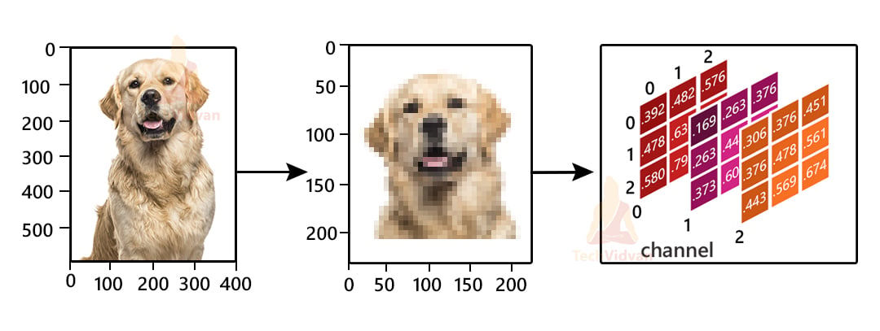
Results and Performance
Transfer learning significantly improves breed classification accuracy compared to training from scratch.
Fine-tuned models can achieve over 90% accuracy on well-curated datasets.
Visualizations like confusion matrices help identify breeds that are often misclassified.
Notes:
Image source: https://techvidvan.com

Slide 10
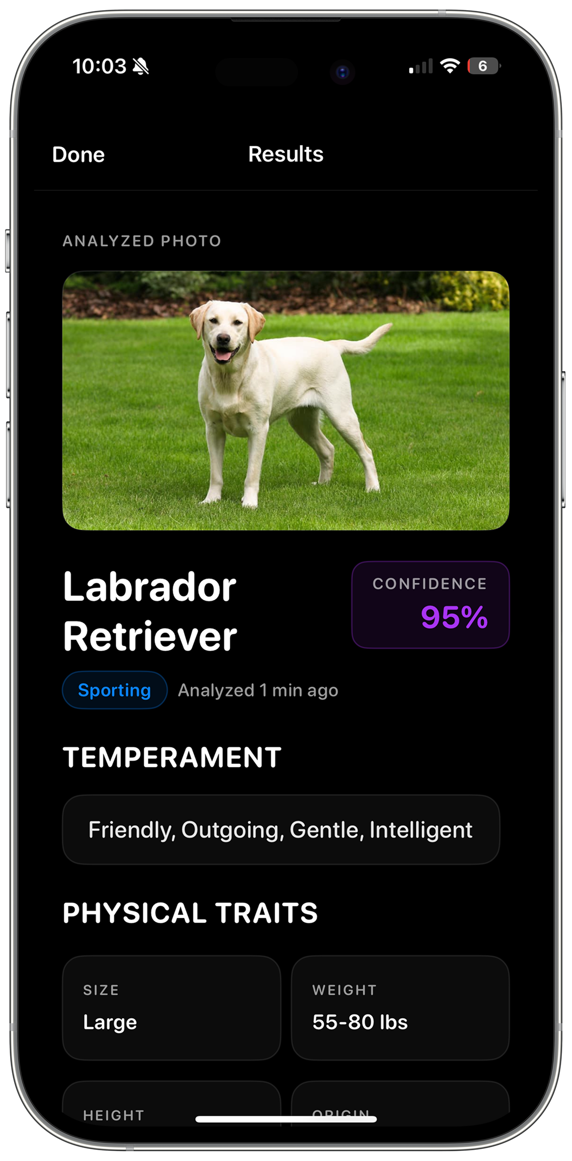
Applications and Future Directions
Automated dog breed identification aids pet owners, shelters, and veterinary services.
Integrating models into mobile apps enables real-time breed recognition.
Future work includes expanding datasets, improving model explainability, and handling mixed breed identification.
Notes:
Image source: https://dogidentifier.app

Slide 11
Conclusion
Transfer learning provides an efficient and effective approach for dog breed classification.
The combination of pre-trained models and data augmentation enhances performance.
Ongoing research aims to improve model accuracy and applicability in real-world scenarios.
Notes:
Image source: https://www.mi-research.net

